Slide 1




NETWORK ANALYSIS WITH PALLADIO
Ruby L Martinez
Notes:
Hello everyone and welcome to the Network Analysis with Palladio workshop. My name is Ruby Martinez your instructor for today’s session.

Slide 2
UNVEIL
HIDDEN
CONNECTIONS
Notes:
The main purpose of this workshop is to get you to consider how network analysis can play a role in unveiling hidden connections. This workshop is designed for digital humanities scholars, graduate students, librarians, and researchers interested in learning how to use Palladio for data visualization.

Slide 3
WORKSHOP INTRODUCTION
Notes:
Network analysis and visualization software have become crucial tools for transforming our understanding of culture, history, and society in the constantly changing field of digital humanities.

Slide 4
WORKSHOP MODULES
01 - INTRODUCTION TO NETWORK ANALYSIS
02 - CREATING A DATASET
03 - GETTING TO KNOW PALLADIO
04 - IMPORTING DATA
05 - SAMPLE VISUALIZATIONS
06 - LIVE DEMO
Notes:
Our workshop modules include a brief introduction to network analysis,
An overview of creating a dataset
Getting to know Palladio and its features
Followed by how to import that data
and some sample visualizations.
I will also be doing a live demo with Palladio as well.

Slide 5




WORKSHOP OBJECTIVES
WORK WITH DATASETS
USING PALLADIO
Learn how to import and manipulate data in Palladio
Gain experience in constructing and refining network datasets
Explore various visualization techniques for network data
Creating informative and visually appealing network visualizations
HUMANITIES NETWORK ANALYSIS
PALLADIO RESEARCH INTEGRATION
Discover how network analysis can enhance humanities research
Uncover hidden patterns and connections within humanities data
Gain the skills necessary to incorporate Palladio into research workflows
Notes:
The main objectives for today is to get you comfortable working with datasets and using Palladio. As well as discovering how network analysis can enhance humanities research and how you can integrate Palladio into your research workflows.

Slide 6
WHAT IS NETWORK ANALYSIS?
Network analysis is a computational method for studying the relationships between interconnected objects or entities. In the context of digital humanities, network analysis can be used to do a number of things.
Notes:
Network analysis is a computational method for studying the relationships between interconnected objects or entities. In the context of digital humanities, network analysis can be used to:
A network is a collection of interconnected nodes. Nodes can represent people, objects, concepts. The lines between nodes represent the relationships between them.

Slide 7
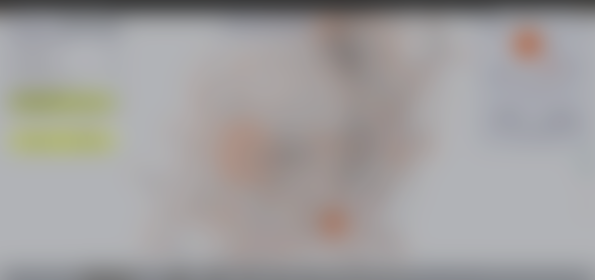
MAP AND VISUALIZE CONNECTIONS BETWEEN CHARACTERS IN A NOVEL, THE RELATIONSHIPS BETWEEN SCHOLARS IN A FIELD OF STUDY, OR THE LINKS BETWEEN WEBSITES ON THE INTERNET.
Notes:
Map and visualize complex relationships between people, ideas, texts, or other objects. For example, network analysis can be used to visualize the connections between characters in a novel, the relationships between scholars in a field of study, or the links between websites on the internet.
A great example of this is the Six Degrees of Francis Bacon project.

Slide 8
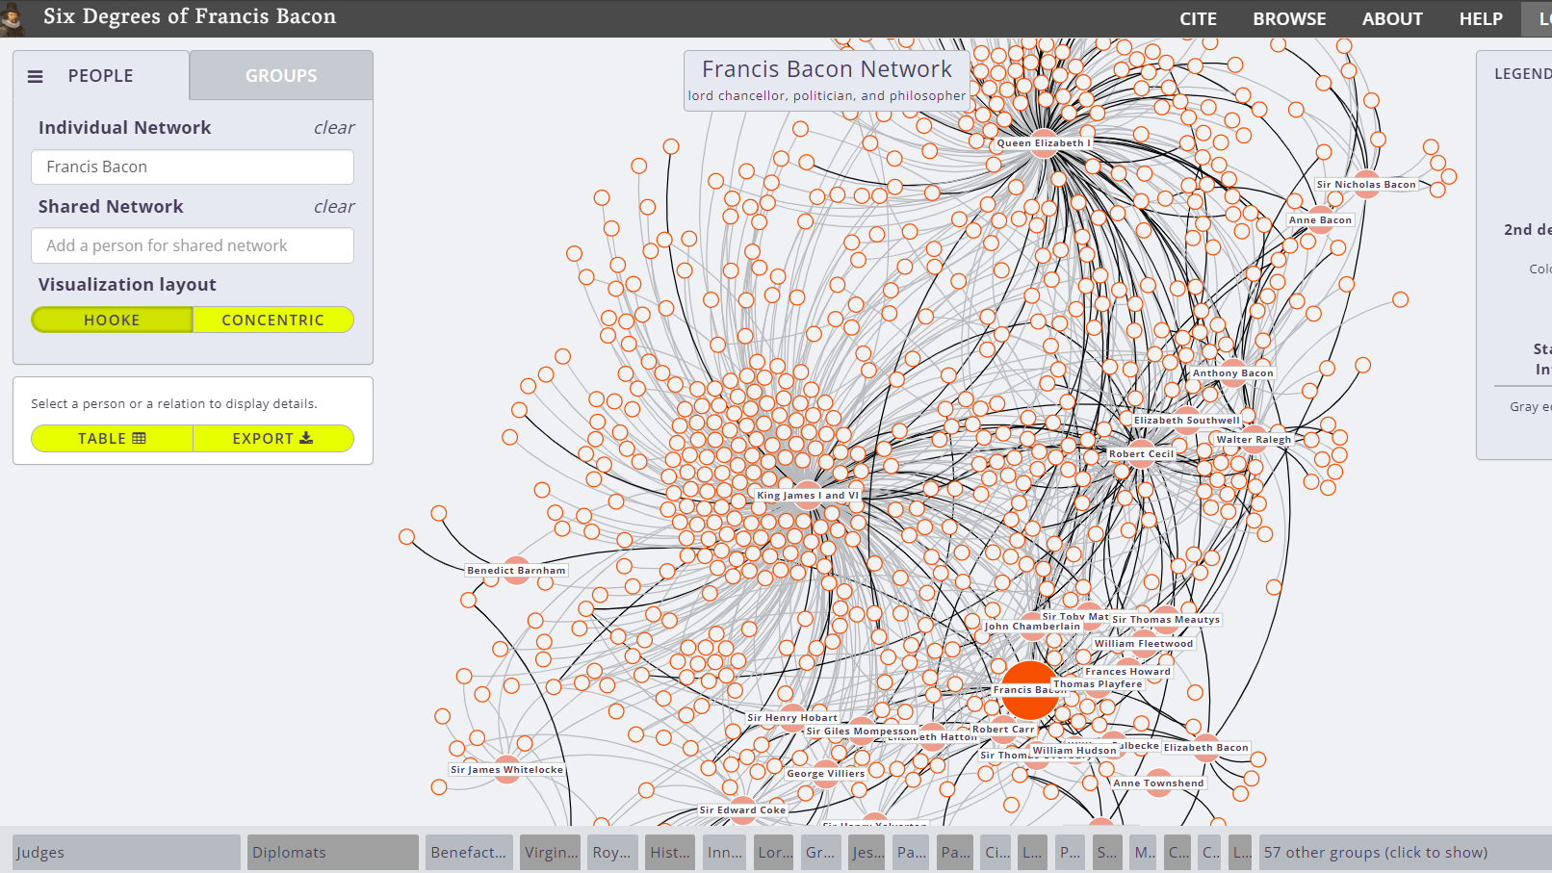
SIX DEGREES OF FRANCIS BACON
This project aims to map the social network of early modern Britain (1500-1700), centered on the influential figure of Francis Bacon.
Project website: http://www.sixdegreesoffrancisbacon.com/
Notes:
This project aims to map the social network of Early Modern Britain from the 1500-1700s and centers on the influential figure of Francis Bacon.
This project utilizes network analysis to visualize the connections/relationships between philosophers, writers, poets, artists, scientists, etc., providing insights into the social, intellectual, and political landscape of that period.

Slide 9
IDENTIFY THE “MOST IMPORTANT” PEOPLE IN A SOCIAL NETWORK, THE “MOST INFLUENTIAL” PAPERS IN A FIELD OF STUDY, OR THE “MOST POPULAR” WEBSITES ON THE INTERNET.
Notes:
Network analysis can also be used to identify influential nodes and communities within a network. For example, network analysis can be used to identify the “most important” people in a social network, the most influential papers in a field of study, or the most popular websites on the internet.
A great example of how network analysis can identify these important concepts is the Open Syllabus Project

Slide 10
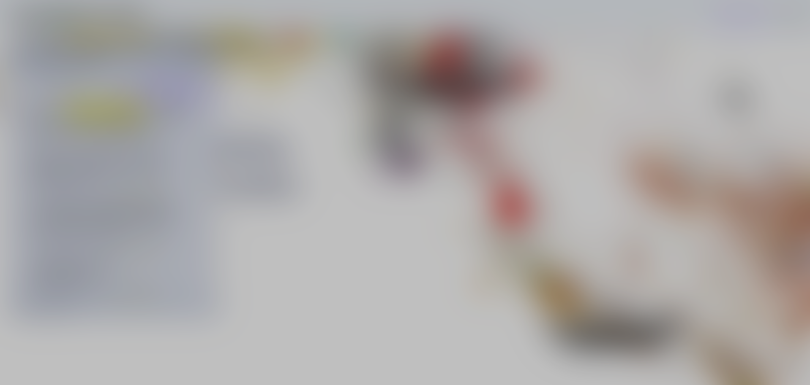
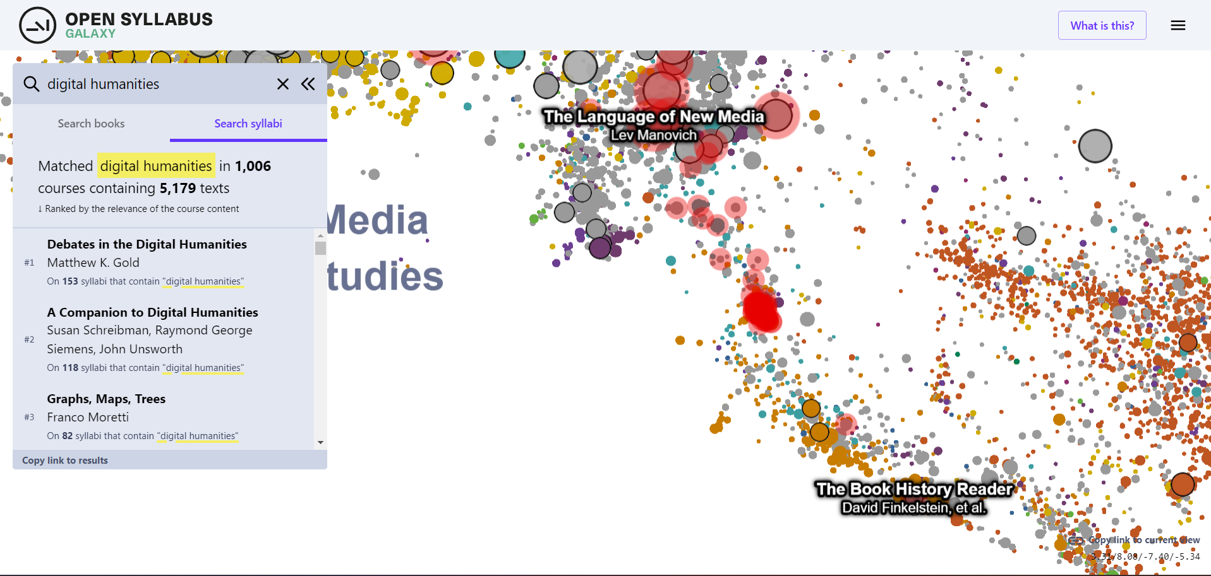
THE OPEN SYLLABUS PROJECT
This project collects and analyzes syllabi from various academic disciplines, allowing researchers to explore the network of knowledge and connections between courses, instructors, and institutions.
Project website: https://www.opensyllabus.org/
Notes:
This project collects and analyzes syllabi from various academic disciplines, allowing researchers to explore the network of knowledge and connections between courses, instructors, and institutions.
In this example, network analysis techniques are applied to identify patterns in syllabus content, curricular trends, and the flow of knowledge across disciplines.
Here’s a screenshot of the database where I searched digital humanities. As you can see, Debates in the Digital Humanities by Matthew K. Gold has been on 153 syllabi.

Slide 11
TRACE THE SPREAD OF IDEAS THROUGH A NETWORK, THE DIFFUSION OF INNOVATIONS THROUGH A POPULATION, OR THE DISSEMINATION OF NEWS THROUGH A MEDIA.
Notes:
It can also analyze the flow of information or influence through a network. For example, network analysis can be used to trace the spread of ideas through a network, the diffusion of innovations through a population, or the dissemination of news through a media.
A great example of this is mapping the republic of letters project out of Stanford.

Slide 12
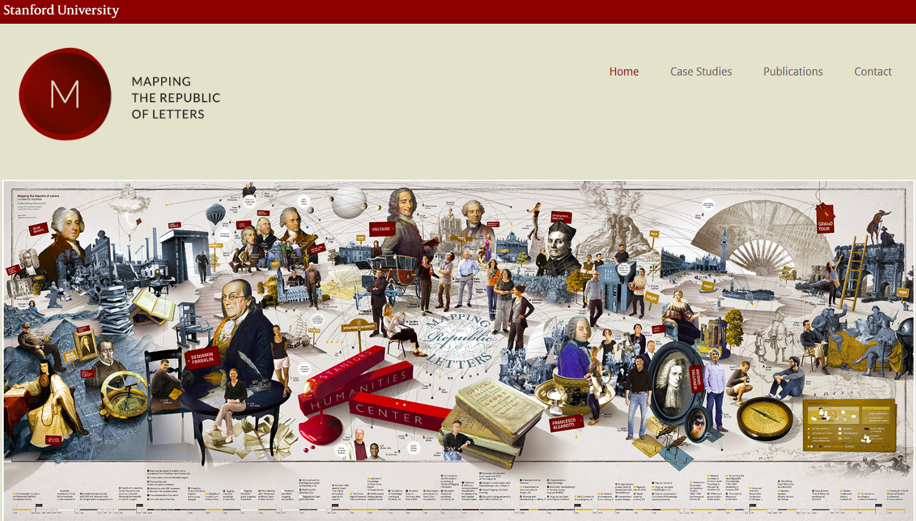

MAPPING THE REPUBLIC OF LETTERS
This project delves into the world of 18th-century European correspondence networks, examining the exchange of letters among scholars, philosophers, and literary figures.
Project website: http://republicofletters.stanford.edu/
Notes:
This project delves into the world of 18th-century European correspondence networks, examining the exchange of letters among scholars, philosophers, and literary figures.
Network analysis helps reveal the interconnectedness of these individuals, the dissemination of ideas, and the formation of intellectual communities.

Slide 13
KEY CONCEPTS
Map relationships and connections between elements.
NETWORKS ARE EVERYWHERE
NETWORKS ARE COMPLEX
NETWORKS ARE DYNAMIC
NETWORKS ARE IMPORTANT
Notes:
But at its most basic level, network analysis is essentially mapping relationships and connections between elements. And as evidenced in the previous projects,
Networks are everywhere. Networks are not just found in the natural world, but also in the social, cultural, and economic worlds.
Networks are complex. Networks are often made up of many different nodes and edges, which can make them difficult to understand.
Networks are dynamic. Networks are constantly changing as new nodes and edges are added and existing nodes and edges are removed.
Networks are important. Networks play a role in a wide variety of phenomena, from the spread of disease to the evolution of language.
So now that we’ve seen some examples of what network analysis can do at a granular level, let’s step back and understand how network analysis can work.

Slide 14
TERMINOLOGY
1
2
3
4
NODES
EDGES
DEGREE
CENTRALITY
Represent the entities we are interested in studying, such as people, organizations, ideas, or websites.
Represent connections between nodes.
The degree of a node is the number of edges that are connected to it.
The measure of how important a node is to a network.
Notes:
So let’s understand the “how” by learning some basic terminology

Slide 15
1
2
3
4
NODES
EDGES
DEGREE
CENTRALITY
Represent the entities we are interested in studying, such as people, organizations, ideas, or websites.
Represent connections between nodes.
The degree of a node is the number of edges that are connected to it.
The measure of how important a node is to a network.
Notes:
Here are four key words that are important to understanding networks.
First we have nodes, which represent the entities we are interested in studying. This can be people, organizations, ideas, and even websites.
Then we have edges, which represent the connections between nodes. So for example, in the context of a social network, edges can represent relationships between people such as friendship, family ties, or professional connections. An edge between two people on Facebook could represent that they are friends.
The degree of a node is the number of edges that are connected to it. Using the same social network example, a degree of 200 would indicate they have 200 friends.
Centrality is a measure of how important a node is to a network. And can be measured in a couples of ways
But for the most part we are going to focus on nodes and edges for this workshop. Now before we get into the hands on components of the workshop, I do want to highlight some network visualizations software that are widely used by the DH community.

Slide 16
Palladio is a network analysis tool from Stanford University's Humanities + Design Research Lab. Palladio is a web-based tool that is designed for scholars who want to explore and analyze their data without having to install any software.
PALLADIO
Gephi is a free and open-source network visualization and exploration software. It is one of the most popular tools for network analysis in digital humanities due to its ease of use and powerful features.
GEPHI
Network Navigator is a web-based tool designed to provide a first glimpse of network data, with both metrics and visualizations. It is a simple and easy-to-use tool that is well-suited for exploring and understanding small to medium-sized networks.
NETWORK NAVIGATOR
Notes:
Gephi can be used to import data from a variety of sources, visualize networks in a variety of ways, and perform a variety of network analysis tasks.
Now we’re ready to move into the heart of the workshop creating a dataset.

Slide 17
CREATING A DATASET
This section will guide you through the process of creating a dataset that effectively captures the relationships and attributes of interest for your research.
Notes:
I want to preface this section by saying there is no right or wrong way to create a dataset. And creating a dataset entirely depends on your needs and how your research question, as well as what the platform you will be using needs.

Slide 18
CREATING A DATASET
DEFINE THE OBJECTIVE
GATHER DATA
DETERMINE SOFTWARE
Clearly define the purpose of your network analysis. Are you examining social networks, transportation systems, or something else?
Collect relevant data that represents nodes and edges. Examples: structured data, APIs, web scraping, etc.
Transform the data into a format suitable for network analysis.
2
4
1
3
5
DETERMINE NODES AND EDGES
DATA PREPROCESSING
Identify what constitutes nodes (entities) and edges (connections) in your network.
Prepare data for analysis (i.e., cleaning, formatting, normalization, etc.)
Notes:
So here’s a sample workflow for creating a dataset. I will be going through these steps individually but also framing these steps with how I used this workflow to create the dataset we will be using for today’s workshop. So before we dive in, let’s get to know our sample dataset.

Slide 19
SAMPLE DATA OVERVIEW
DATA SOURCE
DATA ELEMENTS
International Conference on Digital Preservation (iPRES) conference proceedings
Data Period: 2022 – 2023
Author
Affiliation
Country
Paper Title
Topics
Submission Year
Notes:
Our sample dataset was retrieved from the conference proceedings for the International Conference on Digital Preservation (iPRES) from 2022 and 2023.
Some of our data elements include Author, Affiliation…
So lets walk through our workflow

Slide 20
1
DEFINE THE OBJECTIVE
What relationships and attributes are essential to understanding your research topic?
What is the purpose of the network analysis?
What questions do you want to answer?
Notes:
Step 1 defining the objective

Slide 21
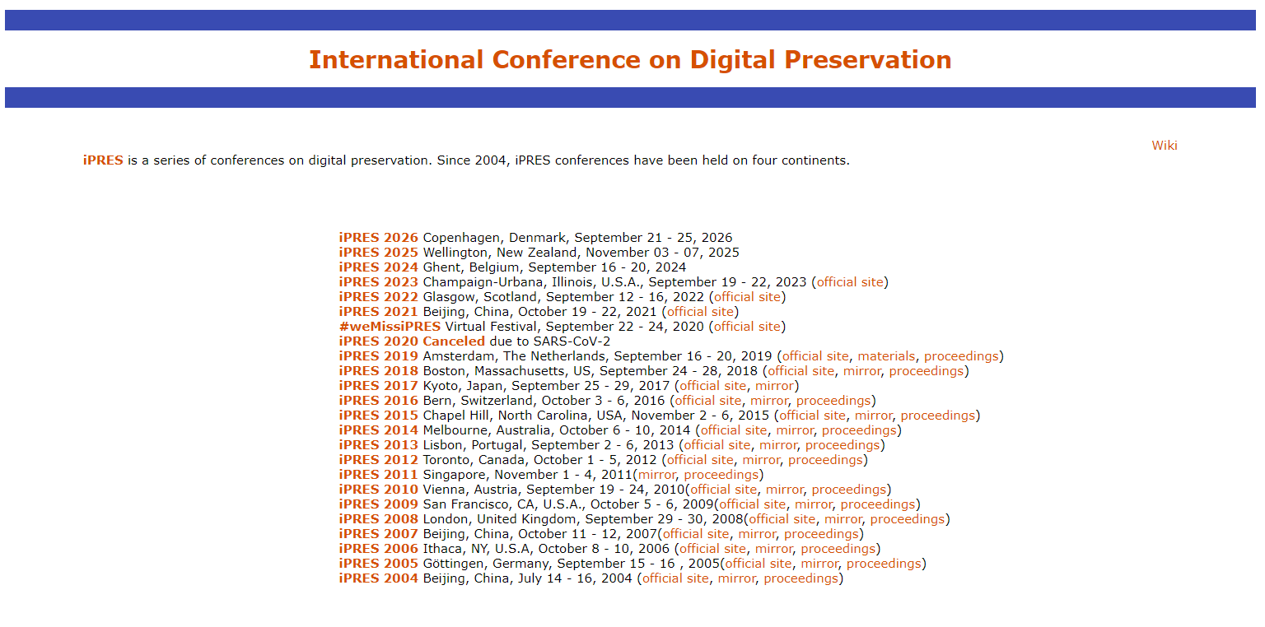
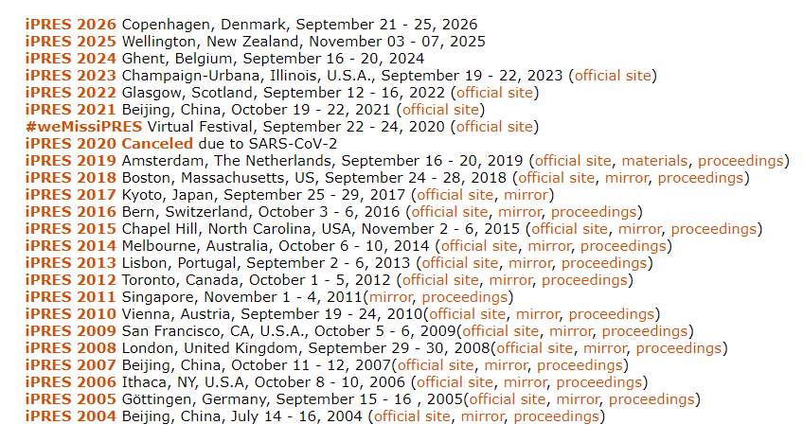
DEFINE THE OBJECTIVE
CONFERENCE PROCEEDINGS
1
What can be learned?
IDENTIFY DATA ELEMENTS
2
What data can be used from the proceedings?
RESEARCH QUESTIONS
3
Co-authorship Patterns: How are authors connected through co-authorship networks?
Notes:
So what this looked like for me, was asking myself what did I want to learn from the iPRES conference proceedings. This conference is the only international conference on digital preservation that first began in 2004. The big picture for me is exploring research connections and trends within the community.
But before I can formulate any research questions, I needed to identify data elements that are available via the proceedings, which is also important for our next step. So like most conference proceedings the data that is publicly available are elements like Author, Affiliation, Country, Paper Title, Topics, Submission Year, etc.
Now that I have an idea of the data I’m working with, some of what I wanted to explore are co-authorship patterns.

Slide 22
2
DETERMINE NODES AND EDGES
What are the core identities or individuals that will be represented as nodes in your network?
What types of relationships or interactions do you want to capture between these entities?
How will you represent these relationships as edges in your network?
Notes:
I put this step before actually gathering the data because it provides clarity in the data collection process. By defining nodes and edges beforehand, you focus on gathering only the necessary data attributes that contribute to constructing the network. This helps avoid collecting excessive or irrelevant information.
But this is a good time to remind you that this workflow is flexible and if you are already working with a preset data than you can identify your nodes and edges by analyzing what you already have.

Slide 23
NODES
EDGES
Nodes could represent people, locations, devices, etc.
Edges represent relationships, interactions or connections between them.
01 - AUTHOR
01 - AUTHOR-PAPER
02 - PAPER
02 - CO-AUTHORSHIP
03 - AFFILIATION
03 -
Notes:
Within the context of our sample dataset. Here are some sample nodes.
Each unique author could be a separate node.
Each unique paper could represent a node.
Edges
Author-Paper Relationship: Create edges to represent the relationship between authors and papers they've written. Each edge connects an author node to a paper node, indicating that the author has contributed to that particular paper.
Co-authorship: Establish edges between author nodes to denote co-authorship. If two authors have collaborated on the same paper, create an edge between their respective nodes to illustrate their collaborative relationship.
This representation allows analysis of relationships between papers, authors, collaborations, and potentially insights into co-authorship networks, paper citations, author affiliations, etc.

Slide 24
3
GATHER DATA
What are the most appropriate data sources for your research?
What combination of primary and secondary sources will you use?
What data collection methods will you employ?

Slide 25
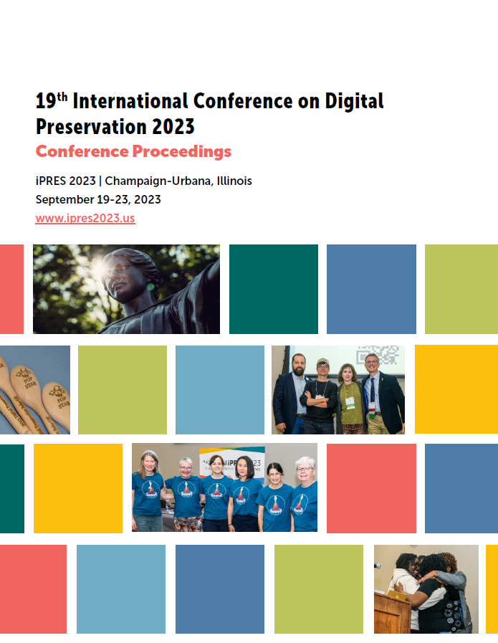
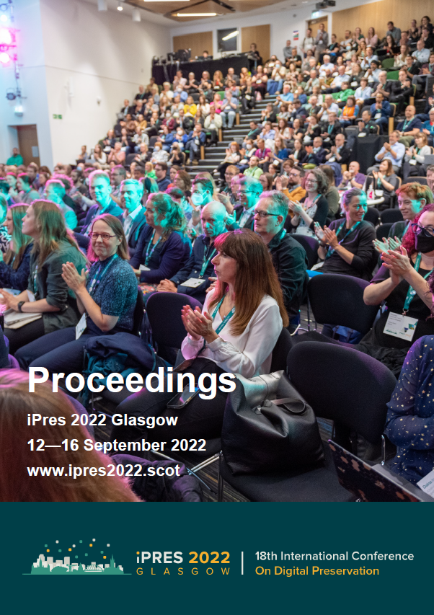
GATHER DATA
ACCESS CONFERENCE PROCEEDINGS
1
This involved visiting websites or platforms hosting the conference proceedings.
EXTRACT DATA
2
This was a manual process and extracted necessary data fields such as: Year, Paper ID, Title, Authors, Affiliations, Keywords, etc.
COMPILE THE DATASET
3
Organized the extracted data into a structured format using Excel or Google Sheets.
Notes:
I gathered the data by accessing the conference proceedings online.
Extract the data was a manual process and involved a lot of copy and paste.
And I structured that data into an excel spreadsheet by organizing it using the data fields like year, paper id, title, etc.

Slide 26
4
DATA PREPROCESSING
What data cleaning techniques will you use to identify and address errors, inconsistencies, or missing values?
How will you organize and structure your data?

Slide 27
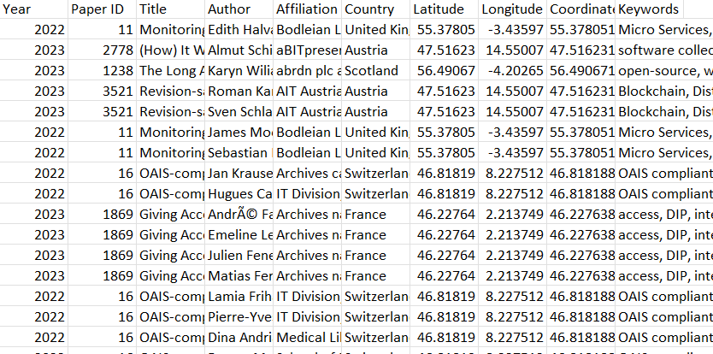
DATA PREPROCESSING
CLEANING
1
Remove duplicates, handle missing values, and standardize formats.
FORMATTING
2
Ensure consistency in how nodes and edges are represented.
NORMALIZATION
3
Normalize data if necessary for uniformity.
Notes:
This is more common step when you’re working with data that wasn’t created by you. And some of these steps are entirely optional.
An example of data cleaning for this dataset was when authors had a paper in both the 2022 and 2023 conference proceedings but only included their middle initial in one year. The computer is going to interpret this as two separate authors even though we know it’s one.
Formatting also comes into play here, especially if you are using platforms that are case sensitive. So you want to make there is consistent formatting across your data. One of the formatting issues I spotted was this right here. This particular author uses diacritics in their name, but when I extracted that data from the conference proceedings excel may have tried to normalize this on its own and somehow a copyright symbol was added. THAT has since been corrected.
Lastly, some examples of normalization can look like removing professional titles from names (i.e. Dr., Mr., Mrs.), if you’re using dates you want to ensure the same date format is being used across the dataset as well.
Palladio accepts cvs and spreadsheets

Slide 28
5
DETERMINE SOFTWARE TO USE
What are the key factors to consider when choosing network analysis software?
What tool(s) would be appropriate based on your data and research objectives?
Notes:
The final step in the workflow is determine what software to use.

Slide 29
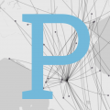
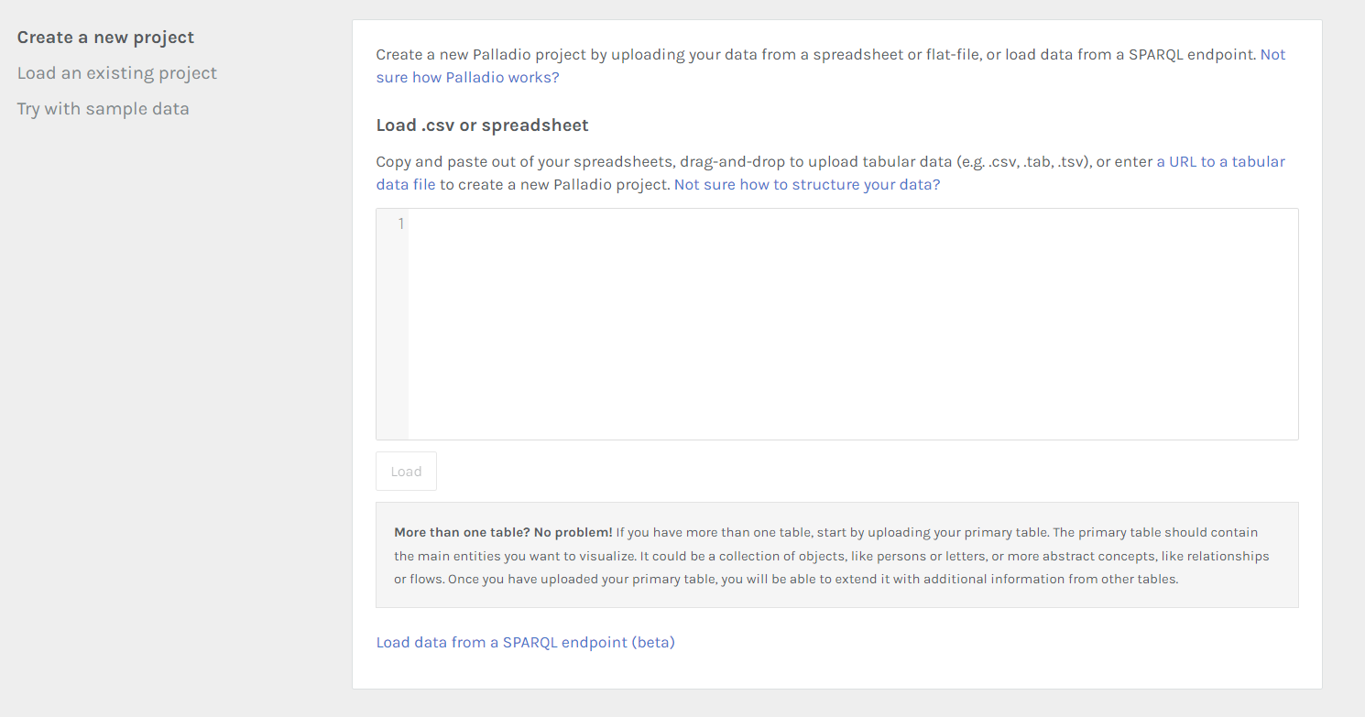
DETERMINE SOFTWARE TO USE
RESEARCH TOOLS
1
Consider aspects like data compatibility, ease of use, and compatibility with other tools.
TRANSFORM DATA
2
Look into the required formats needed to use the software. Ex. Palladio requires CSVs or spreadsheets
UPLOAD YOUR DATA
3
Get to know the tool by playing around!
Notes:
Determining what software to use requires YOU GUESSED IT researching the tools. Some aspects you’ll want to consider is whether or not your data is compatible with the software, how easy is it to use, is it compatible with other tools. How much time and effort can you invest to this project?
Since we’re going to be working with a fairly small dataset, I wanted to use Palladio because of its intuitive features which I’ll go into more detail in a couple of slides.
But all that’s left to do here is to transform your data into the required format of whatever tool you’ll be using and just upload your data.
Sometimes you’ll find after you’ve gotten to know the tool a little bit more, you’ll identify different ways in structuring your data to get more specific results.

Slide 30
GETTING TO KNOW PALLADIO
This section will introduce you to the fundamentals of Palladio, equipping you with the knowledge and skills to navigate its interface and embark on your network analysis journey.
Notes:
And with that we’re ready to get started with getting to know the star of the show, Palladio.
Palladio, a web-based data visualization tool and widely used in the DH community. Its intuitive interface and comprehensive features make it an invaluable tool for exploring complex relationships and uncovering hidden patterns. This section will introduce you to the fundamentals of Palladio, equipping you with the knowledge and skills to navigate its interface and embark on your network analysis journey.

Slide 31
What is Palladio?
Functionality
Key Features
A user-friendly, web-based platform for visualizing complex data and conducting network analysis.
Project of the Humanities and Design Research Lab at Stanford University.
Enables exploration of connections, relationships, and patterns within datasets.
Interactive interface: allows dynamic manipulation and visualization of data
Customizable visualizations: offers flexibility in creating tailored network maps and visual representations.
Edges

Slide 32



THE FOUR VIEWS OF PALLADIO
1
3
4
2
MAP VIEW
LIST VIEW
GALLERY VIEW
GRAPH VIEW
Displays geospatial data as either a single point, or as lines connecting two points.
A table view, in which the full data set can filtered through simple data processing parameters.
Images and metadata associated with data points can be viewed and filters in a display grid.
Conceptual web connecting data points and attributes (i.e. nodes and edges).

Slide 33
1
2
3
4
MAP VIEW
GRAPH VIEW
LIST VIEW
GALLERY VIEW
Displays geospatial data as either a single point, or as lines connecting two points.
Conceptual web connecting data points and attributes (i.e. nodes and edges).
A table view, in which the full data set can filtered through simple data processing parameters.
Images and metadata associated with data points can be viewed and filters in a display grid.

Slide 34
IMPORTING DATA
This section will guide you through the process of importing data into Palladio.
Notes:
So before we get into the hands on partion of the workshop and I want to quickly walkthrough importing data.
Palladio facilitates seamless data import from various sources, enabling users to effortlessly incorporate their data into the platform.

Slide 35
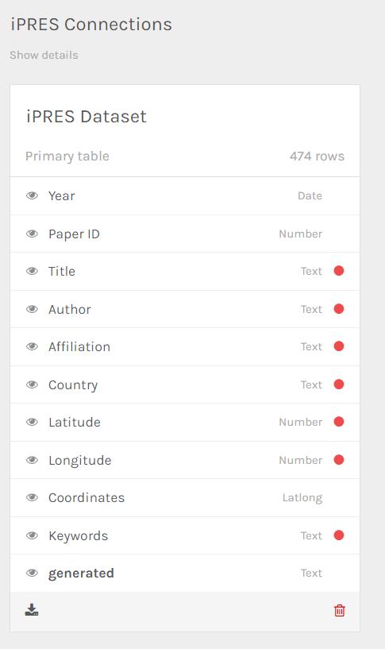
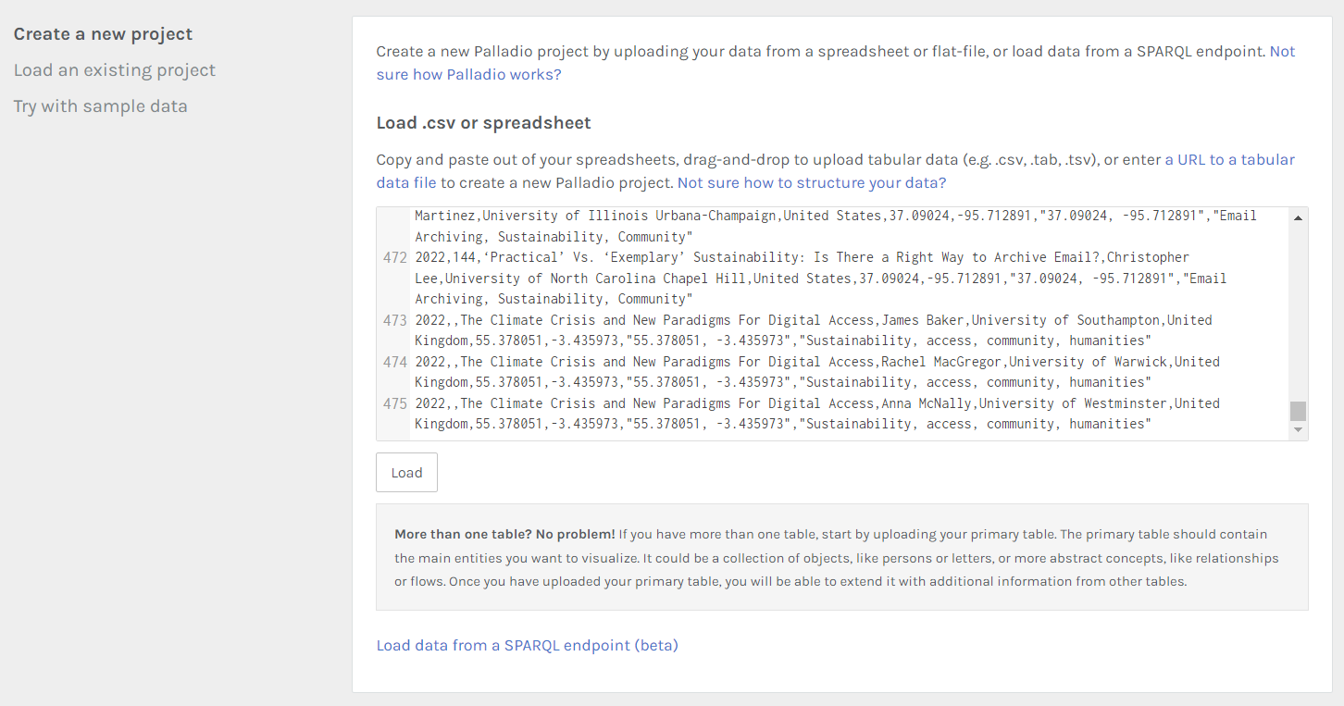
GETTING STARTED
DATA VERIFICATION
1
Ensure the data is in a format compatible with Palladio. Supported formats include CSV, TSV, and Excel spreadsheets.
CREATE A NEW PROJECT
2
Launch Palladio and click the “Start” button to initiate a new project.
LOAD SPREADSHEET
3
Drag and drop or copy and paste to upload the data.
Notes:
Ensure the data is in a format compatible with Palladio. Supported formats include CSV, TSV, and Excel spreadsheets. In this case, the sample dataset is already saved in CSV format.
You will launch Palladio in your web browser and click start. You will be directed to this page and instructed to load your data. You can do this by copying and pasting your spreadsheet direct from excel.
OR you can drag and drop your file into the empty box.
Once you’ve done this the box will no longer be blank. You can do a quick glance through to make sure everything looks good before clicking LOAD.
After clicking LOAD, you will be shown a high-level view of your data, which Palladio calls DIMENSIONS. Most of the dimensions will auto fill. for example YEAR auto fills to date. Paper ID auto fills to number, in this instance, even though the Paper ID is a number we are not using this dimension as numerical data. So we can update this dimension to be read as TEXT instead. I will walk through all this in more detail during the demonstration.

Slide 36
SAMPLE VISUALIZATIONS
This section will showcase a selection of sample visualizations, highlighting the versatility and power of Palladio's visualization tools.
Notes:
BUT before we do that, I want to walk through some sample visualizations and provide a general overview of Palladio’s functionality.

Slide 37
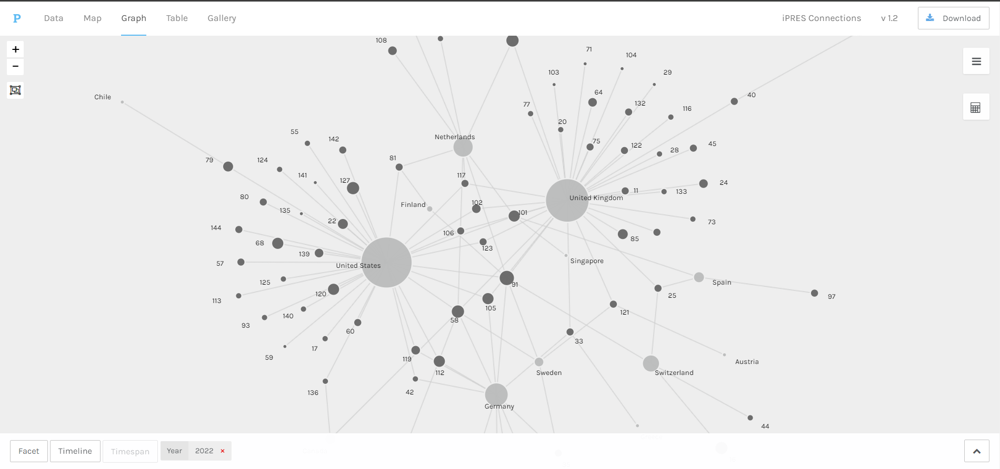

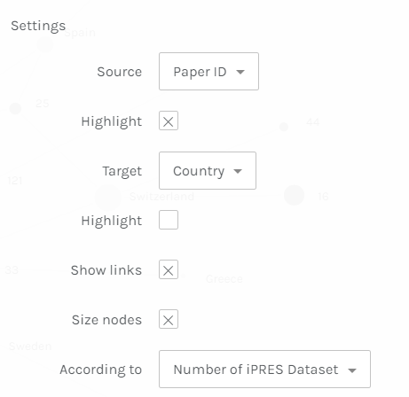
SAMPLE VISUALIZATION 1
Graph View of paper submissions and countries.
Notes:
Our first visualization utilizes the GRAPH VIEW.
These are the standard settings Palladio allows you to manipulate. Now I know what you’re thinking, none of these say nodes or edges.
Palladio uses the concepts of SOURCE and TARGET which directly translate to the concepts of nodes that we talked about earlier.
In Palladio, when you're working with a dataset that involves connections or relationships between entities (e.g., people, places, events IN THIS CASE PAPER ID AND COUNTRY), the 'source' represents the origin or starting point of a relationship, while the 'target' signifies the endpoint or destination of that relationship.
In terms of network analysis, these 'sources' and 'targets' become the nodes, which are the individual entities within the dataset, and the connections between them become the edges, representing the relationships or interactions.
So for example, each Paper ID and country is a node and the connections between them would be the edges.
This visualization showcases the relationship between paper submissions and countries, highlighting that the United States and the United Kingdom had the most representation in iPRES 2022. You can also start to see the collaborations between countries on a specific paper the more you zoom into the visualization.

Slide 38
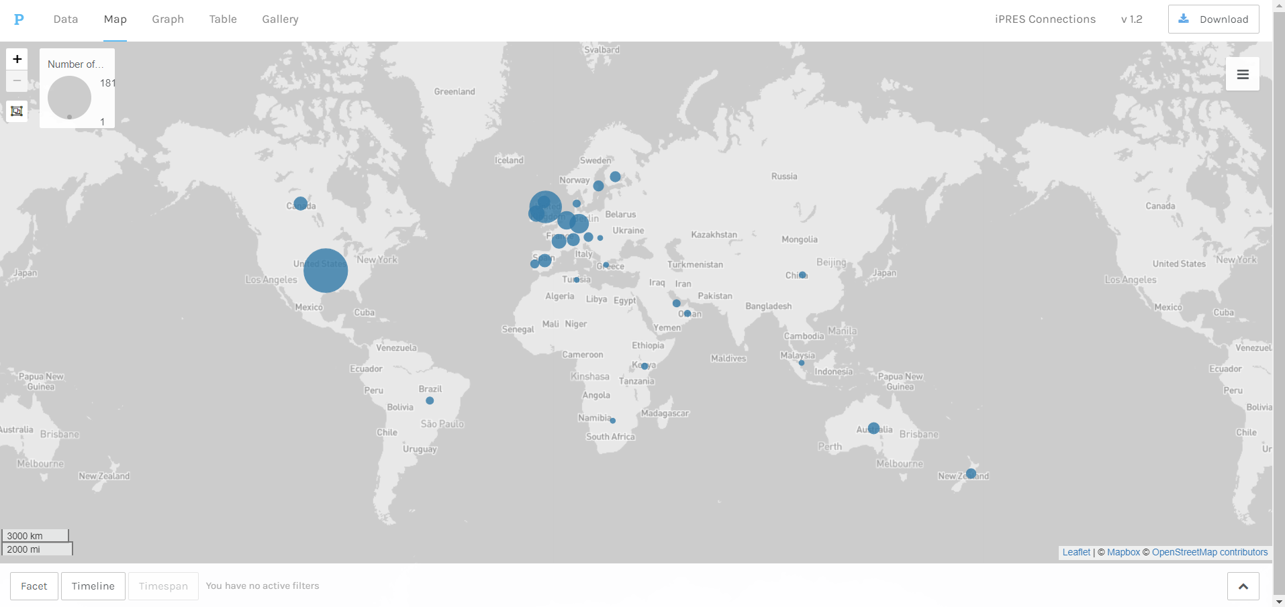
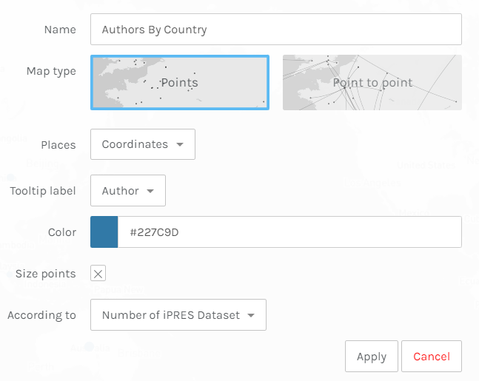
SAMPLE VISUALIZATION 2
Map View of countries with the nodes sized by how many times the countries were listed in the dataset.
Notes:
The second visualization utilizes the MAP VIEW and showcases the countries of where the authors are affiliated. The size of the nodes is determined by how much that country is referenced in the dataset. Similar to our last visualization the US and the UK make up a bulk of that representation for the conference. It will be interesting how the nodes change if we were to work with a dataset that consisted of more than two iterations of the conference.

Slide 39
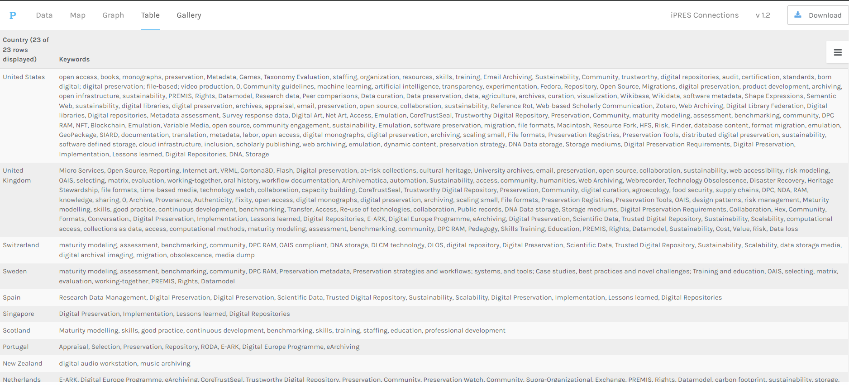
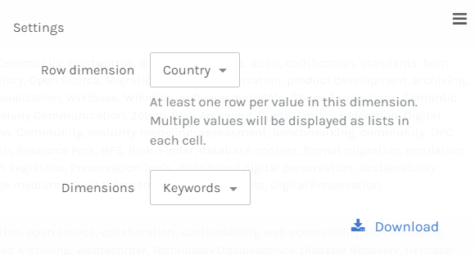
SAMPLE VISUALIZATION 3
Table View of countries and the keywords from submissions.
Notes:
Our final visualization utilizes the TABLE VIEW. This visualization highlights keywords on a submission by country. This feature is incredibly useful to quickly consolidate data and identify any trends in topics for example.

Slide 40
LIVE DEMO OF PALLADIO
Notes:
Now I’m going to walkthrough all of this but live!

Slide 41
SOME ETHICAL CONSIDERATIONS
PRIVACY CONCERNS
POWER AND INFLUENCE
TRANSPARENCY
ACCOUNTABILITY
Notes:
Ethical challenges
Privacy concerns: Network analysis can be used to collect and analyze sensitive personal data. Scholars need to be careful to protect the privacy of individuals when using network analysis.
Power and influence: Networks can be used to map and analyze power relationships. Scholars need to be aware of the potential for network analysis to be used to reinforce existing power structures or to identify and target marginalized groups.
Transparency and accountability: Scholars need to be transparent about their use of network analysis and accountable for the results of their research.
Despite these challenges, network analysis is a powerful tool that can be used to make significant contributions to the digital humanities. Scholars who are aware of the challenges and take steps to address them can use network analysis to gain new insights into a wide variety of digital humanities topics.

Slide 42
SUMMARY
Networks are everywhere. Networks are complex. Networks are dynamic. Networks are important.
Notes:
So to summarize, networks are everywhere, they are complex and dynamic, but most important they are important. Networks are everywhere. Networks are not just found in the natural world, but also in the social, cultural, and economic worlds.
Networks are complex. Networks are often made up of many different nodes and edges, which can make them difficult to understand.
Networks are dynamic. Networks are constantly changing as new nodes and edges are added and existing nodes and edges are removed.
Networks are important. Networks play a role in a wide variety of phenomena, from the spread of disease to the evolution of language.
I hope this workshop was able to equip you with understanding the basics of network analysis and its application in digital humanities research. I also hope that you leave this workshop with the confidence to create or work with a dataset, but more importantly the confidence to use tools that are designed to visualize and analyze your data. It makes for a fun way to unveil those hidden connections and apply them to your research goals.

Slide 43
REFERENCES
Ahnert, R., Ahnert, S. E., Coleman, C. N., & Weingart, S. B. (2020). The Network Turn: Changing Perspectives in the Humanities. Cambridge University Press.
Düring, M. (2015). From hermeneutics to data to networks: Data extraction and network visualization of historical sources. The Programming Historian.
Giovanna Ceserani. (2015). Interactive Visualizations for British Architects on the Grand Tour in eighteenth-century Italy [Palladio Components, HTML, CSS, Javascript, JSON, and Markdown files]. Stanford Digital Repository. Available at http://purl.stanford.edu/ct765rs0222
Humanities + Design Lab at Stanford University. (2023). Palladio. Version 1.2.4. [Web]. https://hdlab.stanford.edu/palladio/.
Newman, M., & Watts, D. J. (2002). The structure and dynamics of social networks. Princeton University Press.
The Open Syllabus Project. (2023). Retrieved from https://www.opensyllabus.org/.
Notes:
Here are a list of my references

Slide 44
THANK YOU
Ruby L Martinez
rubylm2@illinois.edu

